Slide 1
Chapter 7 The Importance Of Public Relations And Earned Media
Simon Hudson

Slide 2
Topics Covered
Introduction to public relations
Public relations techniques
Measuring the impact of public relations efforts

Slide 3
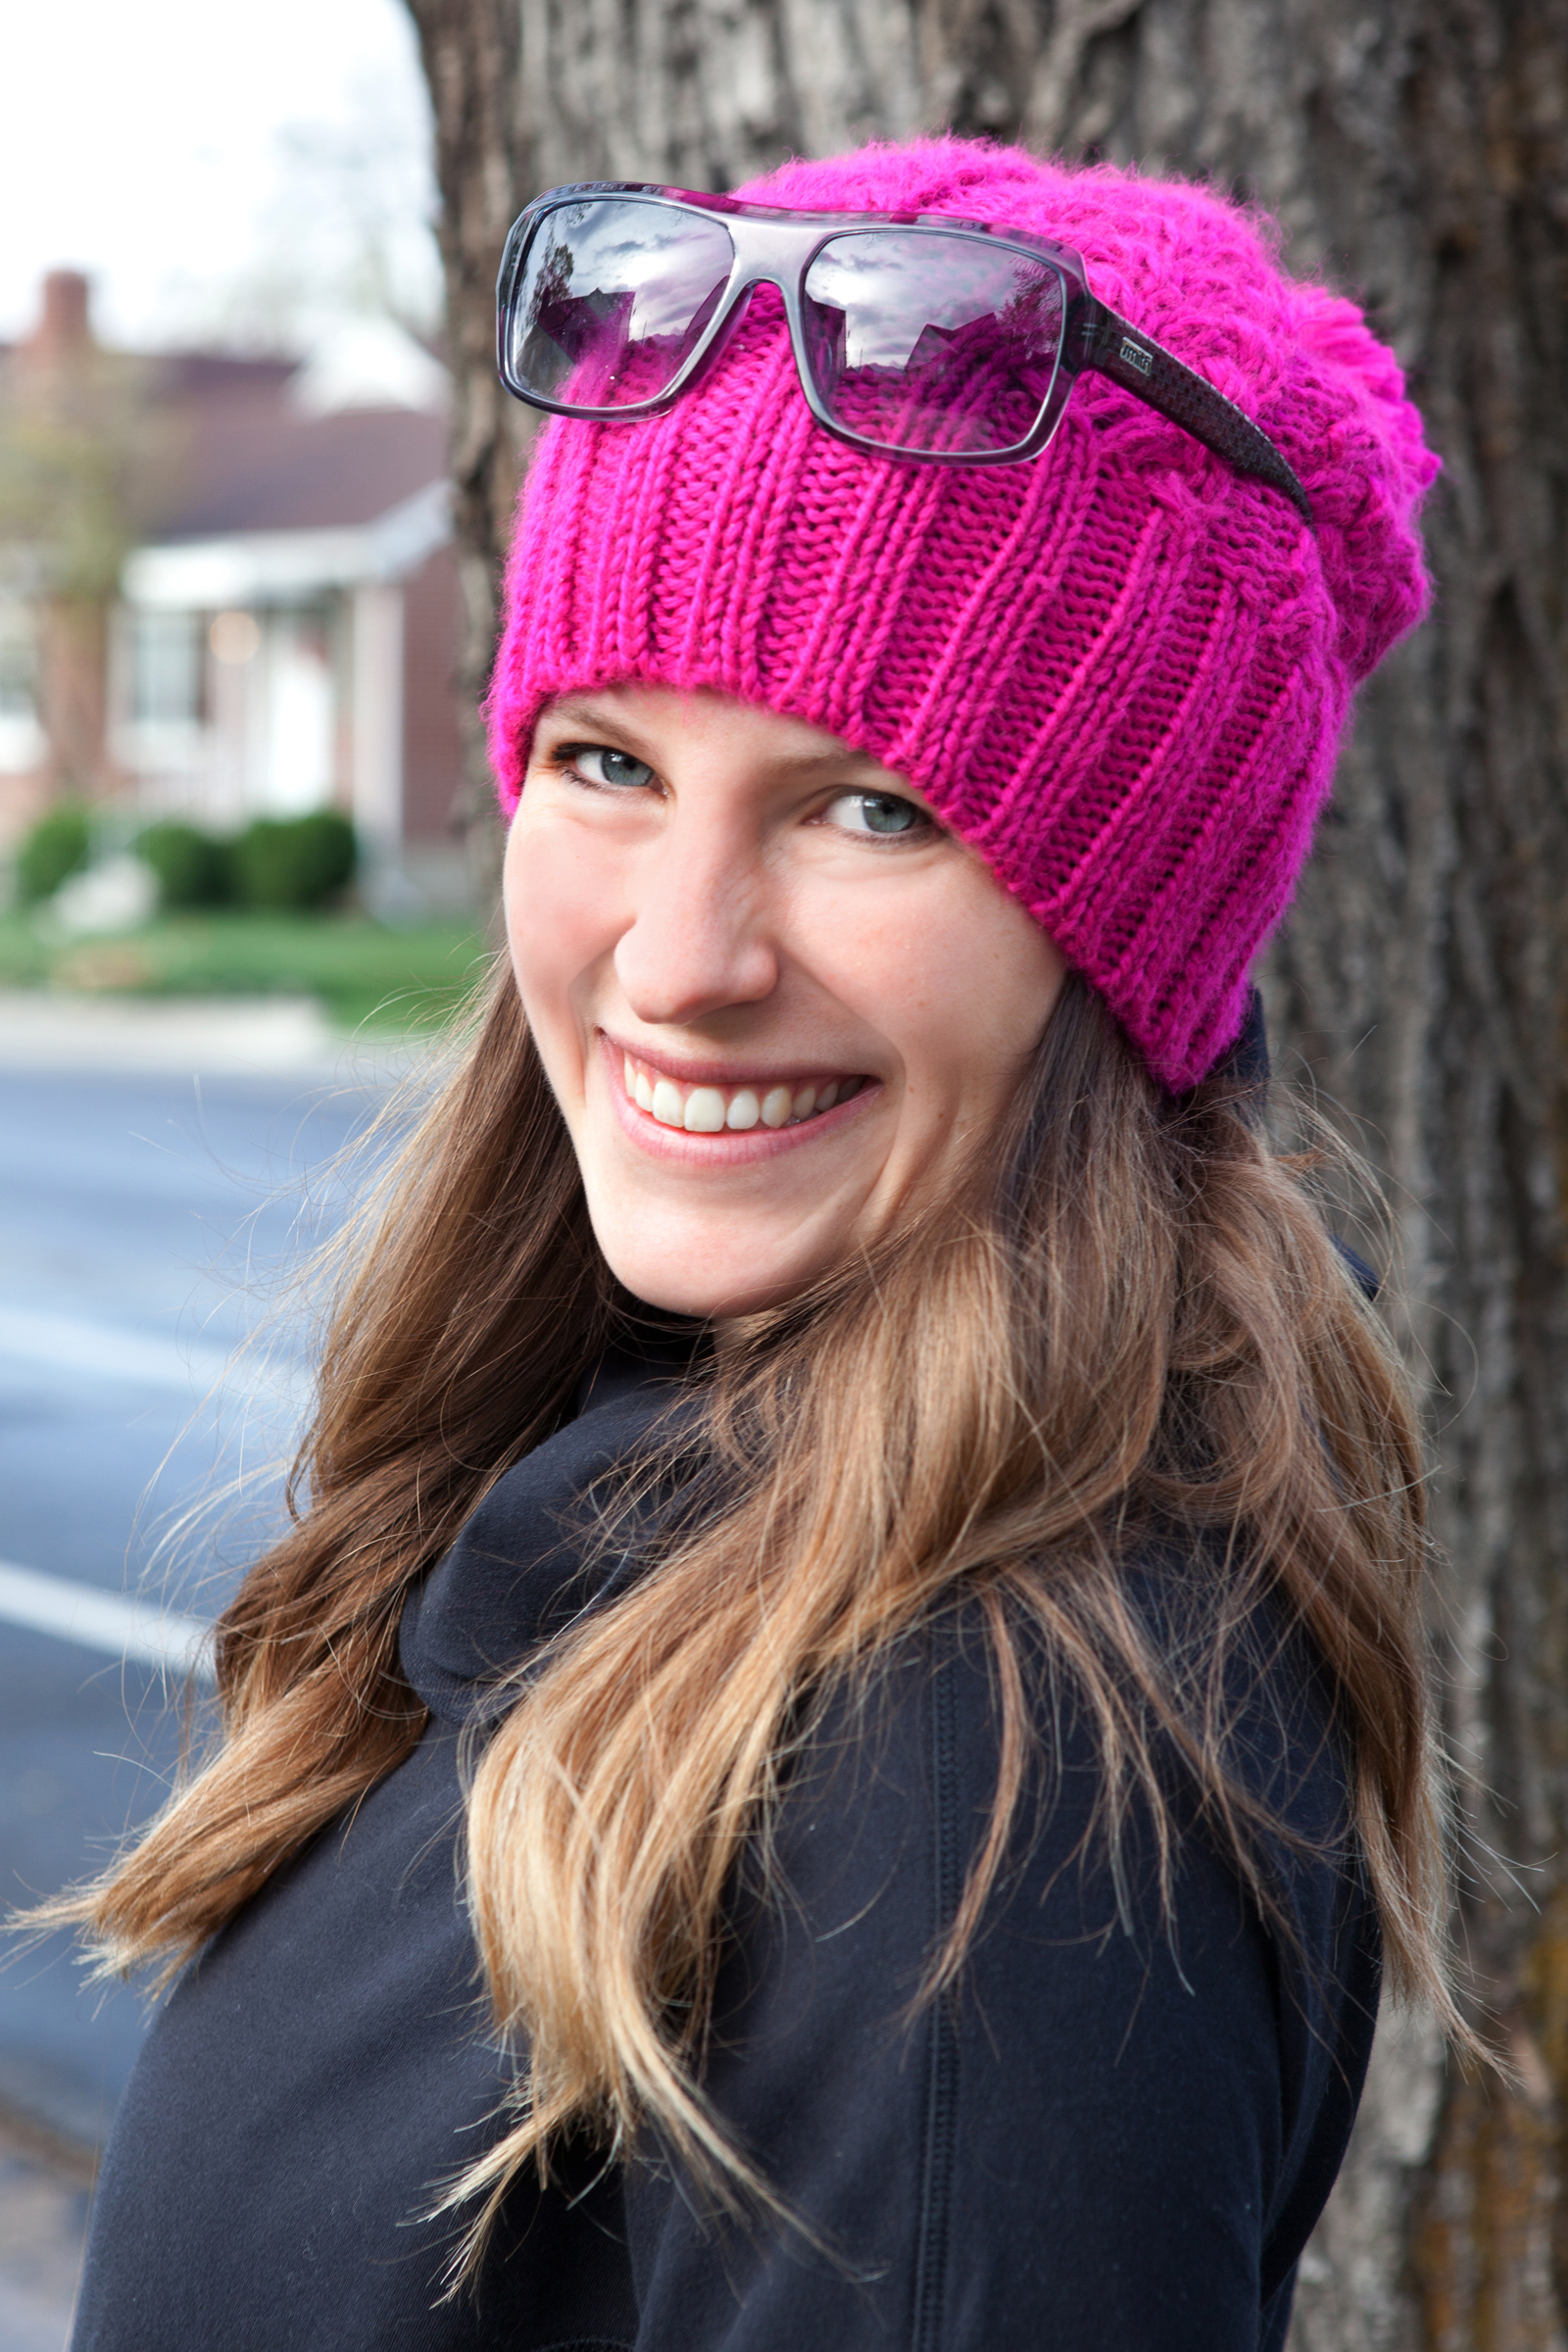
Spotlight Susie English: Perfect PR
Public relations changed with social media
A communications director: keep abreast – and ahead – of the competition.
Pre-requisites for a career in winter sports PR

Slide 4
Introduction to public relations
Types of media available to PR specialists
owned, paid, and earned media
The three most important roles of PR
maintaining a positive public presence, handling negative publicity, and enhancing the effectiveness of other promotional mix elements

Slide 5
Selected public relations techniques available to marketers
Key PR Techniques
Press Releases and Press Conferences
FAM Trips
Travel Exhibitions & Road shows
Hosting & Sponsoring Events
Cause-Related Marketing
Social Media
Publications
Winning or Sponsoring Awards
Celebrity Endorsement
Product Placement & Branded Entertainment

Slide 6
Public relations techniques
Press releases and press conferences
FAM trips
Travel exhibitions and road shows
Hosting and sponsoring events
Cause related marketing
Social media
Publications
Winning or sponsoring awards
Celebrity endorsement
Product placement and branded entertainment

Slide 7
A checklist for putting a FAM trip together
Checklist | Explanation
Plan ahead | There is never a great time to give comp rooms or ski passes etc., but most destinations are seasonal and factor in the cost of FAM trips to their overall marketing and public relations budget. So if you can, pick a relatively low occupancy week.
Gather media lists | You need to prioritize as to who is a priority to invite and why. You need to be strategic about every invitation that will go out. Established and trusted travel writers make great guests, because they could write multiple stories on your destination which may be picked up by two or more publications.
Seek help from your local CVB | The local visitors' bureau is a great resource for media lists, verifying reporters' backgrounds, and other information. They may also help you with providing fillers, such as access to city sites and venues, or partnering restaurants, which will make your press trip a full experience. CVBs can also assist with transportation contacts and more.
Decide what expenses to cover | You should research what the norm is for your area by asking your CVB, and then make your decision. Naturally, room, tax and breakfast should be included for everyone, as well as access to amenities. Your itinerary should include airport transfers for those flying, and parking passes for those who are driving.
Create an interesting itinerary | Most journalists will want to have a variety of memorable experiences to write about. You should welcome this opportunity to "sell" your destination. Be creative and informative in your descriptions.
Send the invitations | Send out invitations 6-8 months in advance and track the RSVPs. Online invitations are effective and acceptable these days. Once the media RSVP, you can send a more detailed itinerary about the press trip.
Block the right rooms | You must be willing to give up several VIP guestrooms out of your block in order to accommodate the press. The media are used to being wowed and you need to provide that extra touch, which will make their stay at your property unforgettable. Remember, the good ones are getting numerous offers and only have a finite amount of time. So be grateful that they want to spend time with you.
Establish goals of FAM trip | Discuss with your team what you are looking to accomplish from this expense. Once you strategically determine the goals of the trip, it will be easier to track its success and consider repeating another one in the future.
Research media | There are several online sources where you can research more about the arriving guests. Information is crucial to understanding more about them, and your can customize their stay accordingly. For instance, if you read in a writer's profile that s/he is a vegetarian, you can let the Chef know in advance. These are the things that your guests will remember.
Welcome gifts | These can make quite an impact so put some thought into these gifts. Make sure you provide a welcome letter, a press kit with contact information, along with any CVB materials, such as lift tickets, free passes, etc. in a separate gift bag.
Dedicate one PR Professional as the main contact | The PR specialist will be the best and most informed contact for the press to ask questions and give tours. The PR contact also has experience in suggesting angles and pointing out special features to the media. The PR contact is also the most appropriate for any media follow-up questions after the FAM trip, as well as facilitating requests for photos and setting up interviews.
Continue to nurture the relationship | Finally, after the FAM trip is over, the publication date of each article may vary depending on editorial calendars, but make sure to maintain the relationship with each writer. These are opinion leaders of the travel industry and the more reason you give them to talk about your destination, the more vacations you will eventually sell, and the better your image will become through editorial endorsement.
Source: Adapted from Lutz, 2014

Slide 8
Branding approaches to CRM
Features | Autonomously Branded | Co-Branded | House Branded | Industry Branded
Charity reputation | Established/ independent of company | Tied to company and charity | Company dependent | Established/ independent of industry
Company’s involvement in charity administration | None | Partial to jointly administered | Company controlled | None
Company control over charity use of funds raised by CRM Program | Limited | Some influence | Complete | Limited
Strategic opportunity | Leverage external brand | Leverage brand congruence | Support existing company/product brand | Leverage industry brand
CRM promotional objective | Demonstrate firm-charity congruence where not obvious | Demonstrate firm-charity brand congruence | Promote firm’s commitment | Promote industry’s commitment
Source: Adapted from Hudson, 2008

Slide 9
Profile John Brice: Combining PR with R’n’R
Snow Sports PR now represents snow sports’ gear manufacturers, mountain lodges, ski areas, heli-ski companies and snow sports’ trade associations.
With the huge influence of the Internet and social media, PR agencies have to keep up with both the amateur industry chatter and professional competition.

Slide 10
Measuring the impact of public relations efforts
PR project: inputs, outputs, outcomes
Traditional media and social media
The effectiveness of product placement and branded entertainment

Slide 11
The Macro Model of Evaluation
Behavior changed
Attitude changed
Awareness increased
Newsletter printed Publicity gained
Event held
Web site posted Social media impression
Copy for newsletter & news release Speaker list & program for event Design & contents for Web site Content for social media
SAMPLE EVALUATION METHODOLOGIES:
Quantitative research
Qualitative research
Observable results
Reader & audience surveys
Media content analysis
Awards
Social media monitoring
Inquiry or response rates
Readership/audience statistics
Circulation/distribution statistics
Pre-testing with focus groups
Readability studies
Case studies
Feedback
Secondary data
OUTCOMES
OUTPUTS
INPUTS
Source: Adapted from Macnamara, 1999

Slide 12
Lake Tahoe Visitor’s Authority PR initiatives in 2012-13
PR initiative | Outcome
Cover story on Sunset Magazine's August "Local's Guide to Lake Tahoe | Circulation of 1.2M
"Tahoe South Guys/Girls" video that reinforces the brand and various passions | Generated more than 58,200 views via First Track Productions’ YouTube Channel
Forbes.com "Greatest sports party on the planet?' Celebrity pro athletes think so" | Media exposure value of $67,800 (10M monthly unique visitors)
LTVA hosted a pre-trip for the North American Snowsports Journalist Association with 18 ski writers from across the US | Stories anticipated to run in the following season
GQ Magazine included Harveys, Opal, Red Hut and Tamarack Lodge | Circulation of 824,000
FORE Magazine wrote a piece on how to ski and golf in the same day "Up the slope and down the fairway" | Circulation of 160,000
Operation Sierra Storm (OSSO) Meteorologist Conference held Jan. 9-12. LTVA and partners hosted 10-12 meteorologists from regional and direct flight markets to conduct live and taped broadcasts from the mountain | Resulted in real-time exposure of early ski season conditions as best in the country while reinforcing the Tahoe South brand. The 2014 OSS event generated Tahoe 48 broadcast stories valued at $2M in media exposure with a potential reach of 45 M national viewers
"Covered in Color" in Contra Costa Times (circ. 174,000); Harrisburg Magazine and Bleecher Report Magazine (circ. 1.2M) - both resulted from Golf the High Sierra Media Tour and South Bay Accent "The New Tahoe" includes Sierra-at-Tahoe, Heavenly and Kirkwood | Circulation of 174,000 for Contra Costa Times Circulation of 1.2M for Harrisburg Magazine and Bleecher Report Magazine
North American Snowsports Journalists Assoc. March 2012 Conference | Circulation 9M; media exposure $165,000+

Slide 13
Measuring traditional media and social media from a PR perspective
Traditional media
Social media
Circulation, reach, impressions
Visits, fans, followers
Share-of-voice
Active advocates
Tone of message
Sentiment ratio
‘Message’ penetration
Audience engagement
Source: Adapted from Ketchum, 2013

Slide 14
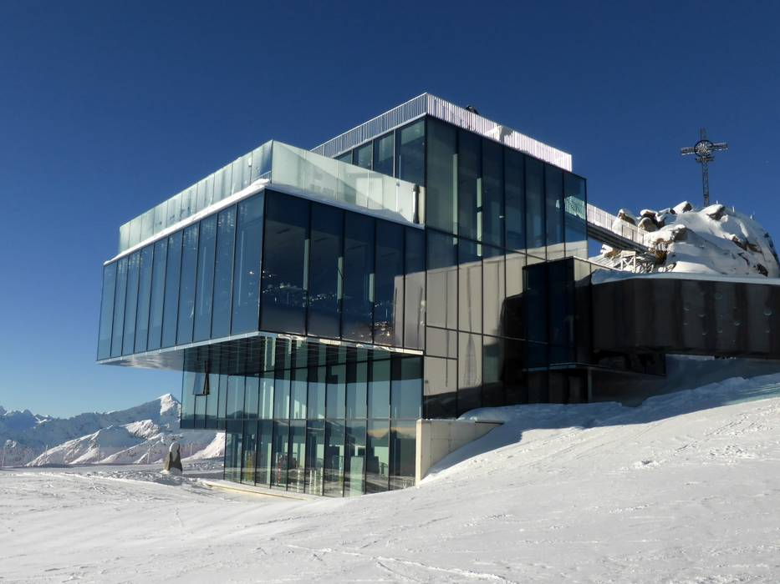
Case Study: 007 puts the spotlight on Sölden, Austria
Economic gains, long-term media impacts and film-tourism opportunities
Sölden is perfect for movie
Ice Q restaurant
Unique glacier location and accessibility

